Slide 1
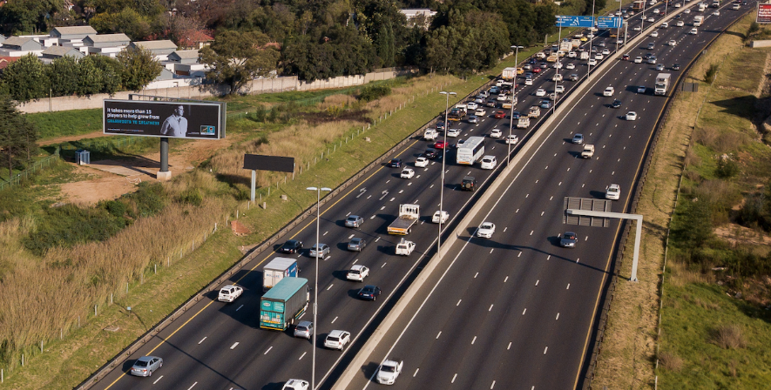
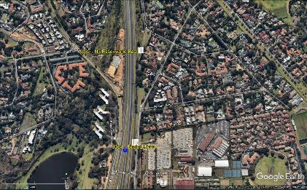
N3 HIGHWAY | ESSEXWOLD | JOHANNESBURG
Rate Card: R320 000 Slot Rate: R75 000 (1/8 slots)
^{Site No.: J062-L}
Size: H x W 4.5 metres x 18 metres
Media Type: Billboard
Orientation: Landscape
Illumination: LED
Panel: Driver’s left
Run-up: 350 metres
LSM: 7-10
Obstructions: None
Billboard situated on the N3 Highway, 500m from the Gillooly’s Interchange,
traffic heading in a southerly direction towards Kensington, Jeppestown,
Edenvale, Isando and JHB CBD.
NEARBY: O.R TAMBO INTERNATIONAL AIRPORT, EAST GATE SHOPPING CENTRE

